Slide 1
Sprint 4 Presentation
Santino Galati, Daniel Fleming, Frank Figueroa

Slide 2
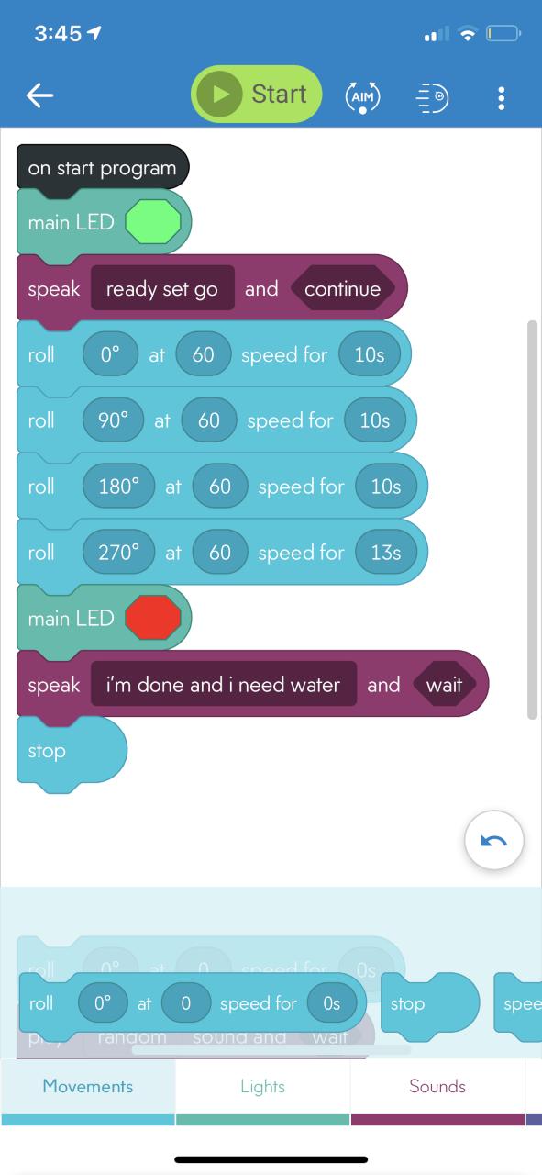
Endurance Block Code

Slide 3
Algorithm of Endurance
1. Start Robot
2. Input robot color to “Green”
3. Input speech “Ready set go”
4. Input robot movement roll 0 degrees degrees at speed “60” for 10 seconds
5. Input spin 90 degrees for 1 second
6. Input robot movement roll 0 degrees degrees at speed “60” for 6 seconds
7. Input spin 90 degrees for 1 second
8. Input robot movement roll 0 degrees degrees at speed “60” for 10 seconds
9. Input spin 90 degrees for 1 second
10. Input robot movement roll 0 degrees degrees at speed “60” for 6 seconds
11. Input spin 90 degrees for 1 second
12. Input robot color to “Red”
13. Input speech “Im done and I need water”
14. End program

Slide 4
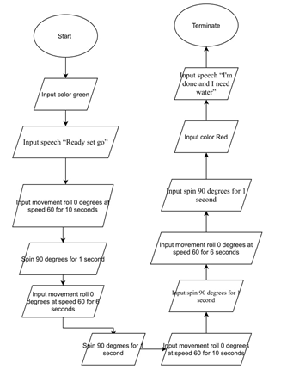
Draw io of Endurance

Slide 5
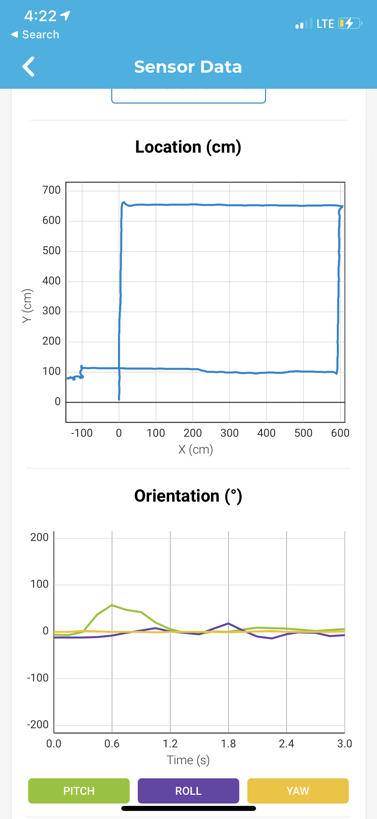
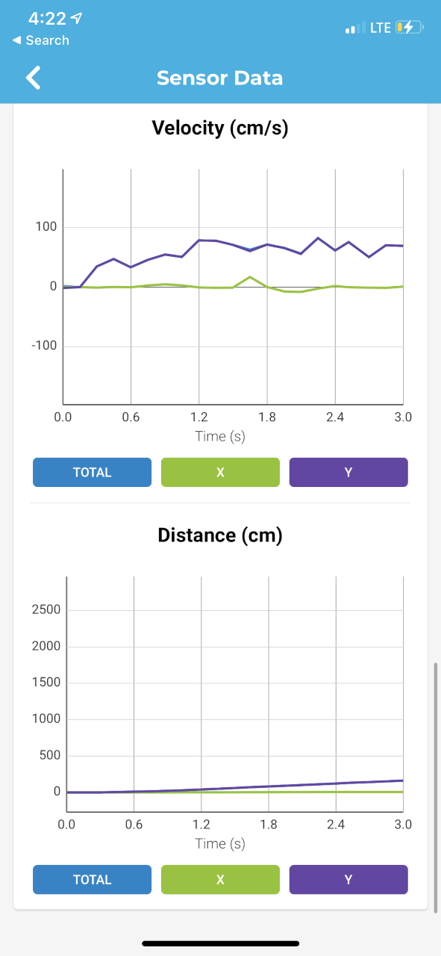
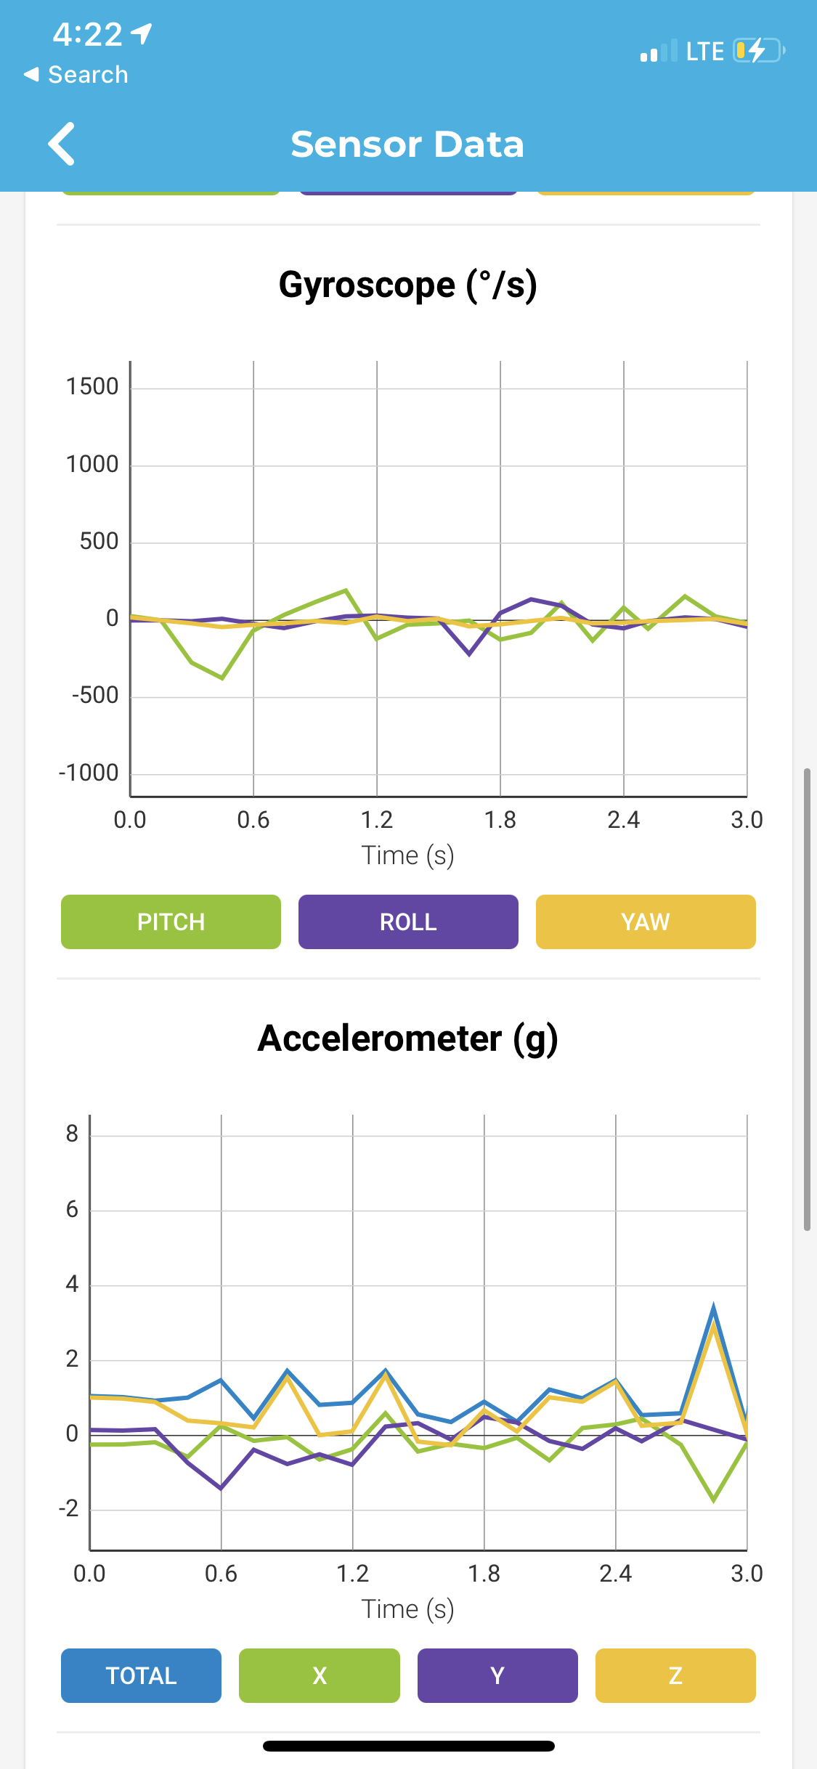
Sensor Data of Endurance
https://www.dropbox.com/s/wnj02gi8tys1c3i/EnduranceSensorData.mov?dl=0

Slide 6
Video of Endurance
https://www.dropbox.com/s/si0d02zmc74y7hg/video%20of%20block%20code%20trial.mov?dl=0

Slide 7
Issues we had with Endurance Sprint
Our code was not giving us the outcome we desired at first then we adjusted it
Having enough space in my house was a challenge so I ran the code outside
Stopping at the corners where we needed to
Wind was pushing robot

Slide 8
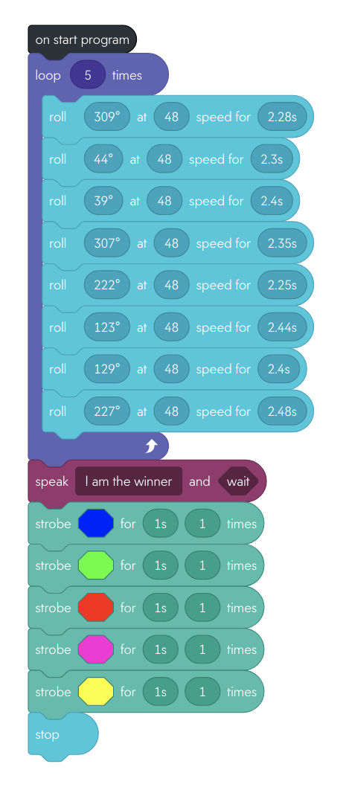
Accuracy Block Code

Slide 9
Algorithm of Accuracy
Start Robot
Roll 309° at 48 speed for 2.28 secs
Roll 44° at 48 speed for 2.3 secs
Roll 39° at 48 speed for 2.4 secs
Roll 307° at 48 speed for 2.35 secs
Roll 222° at 48 speed for 2.25 secs
Roll 123° at 48 speed for 2.44 secs
Roll 129° at 48 speed for 2.4 secs
Roll 227° at 48 speed for 2.48 secs
Loop 5 times
11. Input speech “I am the winner”
12. Input robot color to “Blue” for 1 sec 1 time
13. Input robot color to “Green” for 1 sec 1 time
14. Input robot color to “Red” for 1 sec 1 time
15. Input robot color to “Violet” for 1 sec 1 time
16. Input robot color to “Yellow” for 1 sec 1 time
17. End program

Slide 10
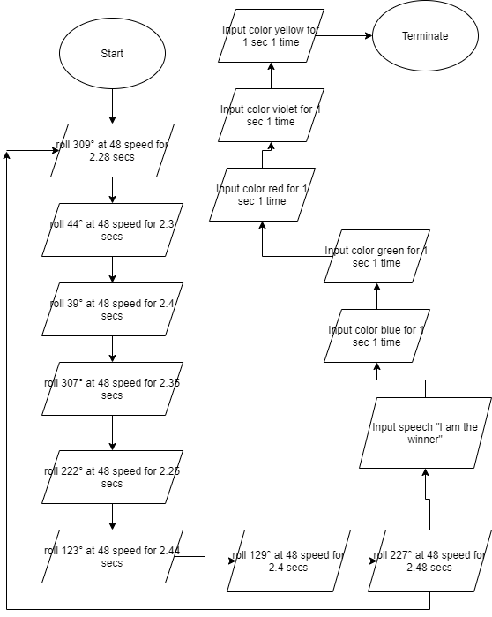
Draw io of Accuracy

Slide 11
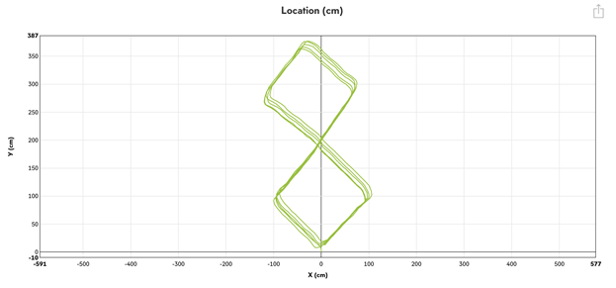
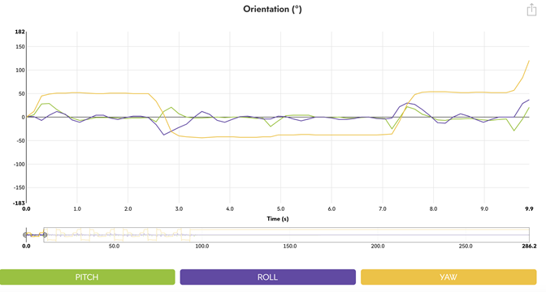
Sensor Data of Accuracy

Slide 12
Video of Accuracy
https://www.dropbox.com/s/zm5nm2ahvxwmqip/RobotAccuracyVideo.mov?dl=0

Slide 13
Issues we had with the Accuracy Sprint
Keeping the Robot on Course
Speed on the Turns
Robot Consistency

Slide 14
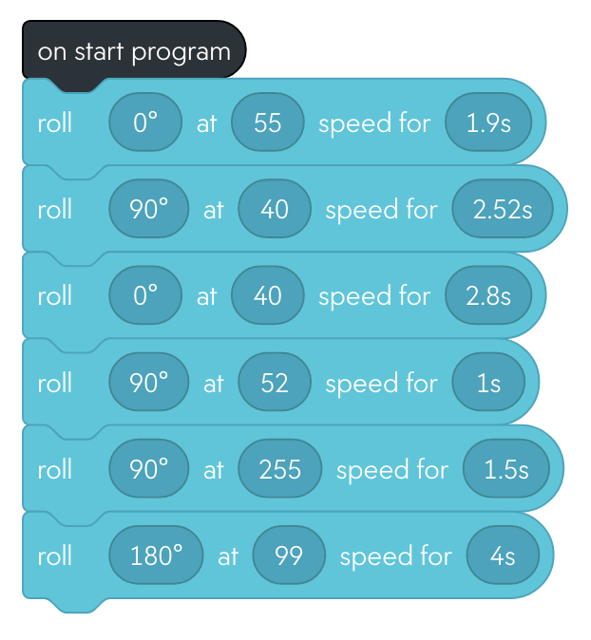
Agility Block Code

Slide 15
Algorithm of Agility
Start Robot
Roll 0° at 55 speed for 1.9 secs
Roll 90° at 40 speed for 2.52 secs
Roll 0° at 40 speed for 2.8 secs
Roll 90° at 52 speed for 1 sec
Roll 90° at 255 speed for 1.5 secs
Roll 180° at 99 speed for 4 secs
End program

Slide 16
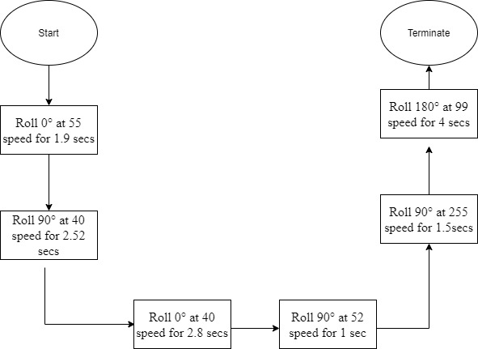
Draw io of Agility

Slide 17
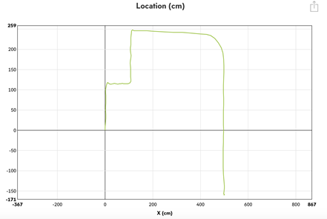
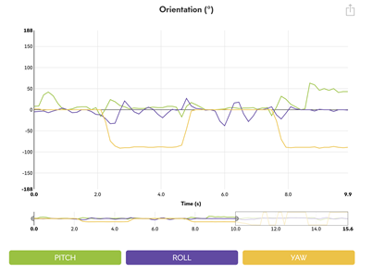
Sensor Data of Agility

Slide 18
Video of Agility
https://www.dropbox.com/s/zsgix384vlwyibl/RobotVideo1.MOV?dl=0
https://www.dropbox.com/s/py83mv9kpzb766v/RobotVideo2.MOV?dl=0

Slide 19
Issues we had with the Agility Sprint
Course Length
Final Turn Before Jump
Knocking Down Pins

Slide 20
What We Learned
How to Work Together as a Team
How to Complete Real Life Problems with Code
The Basics of Programming

Slide 21
What Would We Do Different?
Run Tests Inside the Lab Room
Collaborate with each other in person rather than via video conference
Find a Better Way to Share Sprint Videos

